Slide 1
Data Lake Value Proposition
Presented by Abiodun Dare
Data Architect

Slide 2
Agenda
Why This Matters to the Board
3–5 Year Cost Avoidance
Why Now?
Data Warehoure v Data Lake
What Happens If We Don’t Act
Data Lake Capabilities (Abstract View)
Data Lake Components
Board-Level Takeaway
Data Lake Architecture
1

Slide 3
Why This Matters to the Board
Healthcare data volumes are accelerating rapidly
Legacy platforms constrain insight and scalability
The Data Lake enables faster, more confident decisions
2

Slide 4
3–5 Year Cost Avoidance
Avoid recurring hardware refresh cycles
Prevent exponential license cost growth
Lower cost per terabyte as data scales
Avoid future re-platforming expenses
4

Slide 5
Why Now?
Data growth is outpacing current systems
Operational and compliance risks are increasing
Delaying action compounds cost and complexity
5

Slide 6
Data Warehouse v Data Lake
Data Warehouse
Data Lake
Structured data only
Demands processing
Need to know the data beforehand
Optimized for query
Flexible
Multiple sources
Leverage Machine Learning
Cheap
5

Slide 7
What Happens If We Don’t Act
Escalating operational costs
Reduced executive visibility
Higher risk of outages and compliance breaches
Competitive disadvantage
6

Slide 8
Data Lake Capabilities (Abstract View)
A single, secure place where a company stores all its data so it can be easily used to make better decisions.
Unified enterprise data intake
Secure and scalable data foundation
Reliable data preparation and enrichment
Self-service analytics and AI enablement
Governance and auditability by design
7

Slide 9
Data Lake Components
Ingestion Layer (Grading: Ingestion Design)
Data is ingested from APIs, FTP servers, and databases using Apache NiFi for routing and transformation, Apache Kafka for event-driven buffering, and Debezium for CDC. This design supports batch and near-real-time ingestion and scales horizontally.
Storage Layer (Grading: Storage & Metadata Design)
A Data Lake on object storage is organized into Bronze, Silver, and Gold zones. Apache HDFS/Hive, Apache Cassandra or MongoDB is used as a NoSQL metadata store for schema registry, dataset definitions, and reference data. Parquet is used for optimized analytics, with encryption and access controls for security.
Processing Layer (Grading: Processing & Scalability)
Apache Spark handles batch and streaming workloads. Delta Lake, Apache Hudi, or Iceberg enable ACID transactions, UPSERTs, and CDC. Apache Airflow orchestrates workflows. The system scales horizontally and tolerates node failures.
Serving Layer (Grading: Serving & Consumption)
Curated Gold datasets are served to BI tools such as PowerBI and Tableau via Trino or Spark SQL. Machine learning frameworks like TensorFlow and PyTorch access the same datasets directly. APIs are supported using FastAPI or Spring Boot.
7

Slide 10
Board-Level Takeaway
This is a strategic business platform
It reduces risk and enables growth
Investment scales with business value
8

Slide 11
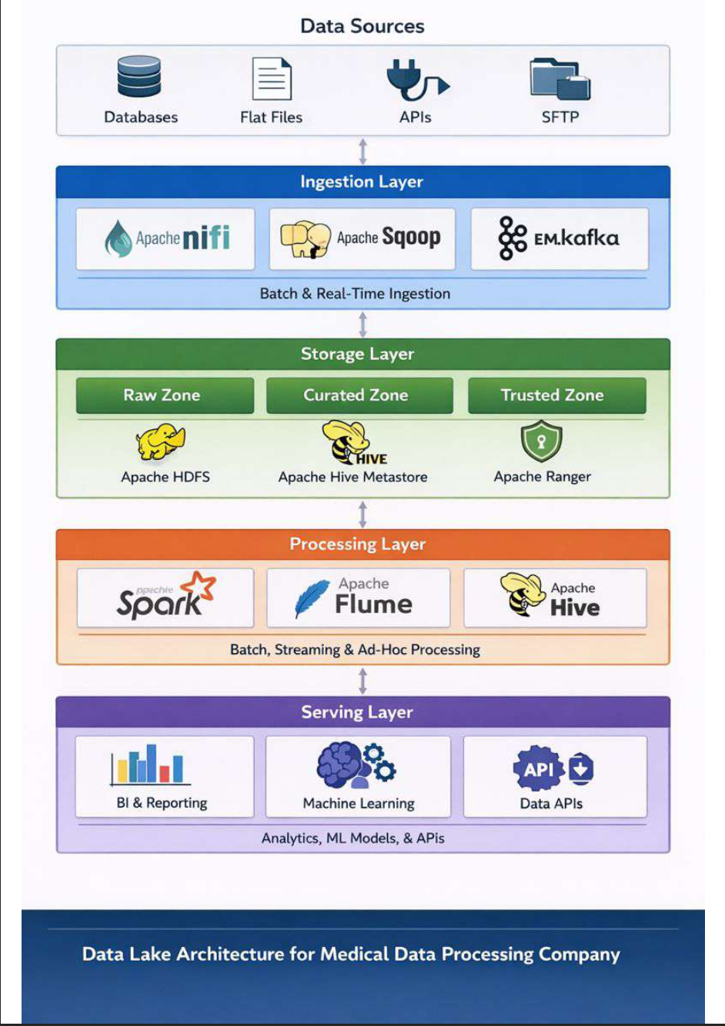
Data Lake Architecture
8

